Slide 1



Elusion DataFrame Library for Everybody!

Slide 2






About me
Motivation
DataFusion
Meet Elusion
Data Wrangling
Development
Contents

Slide 3
About Me

Slide 4


About Me
Music School
Jovan Bandur – Pancevo, Serbia
High School - Sports Gymnasium
Belgrade, Serbia
B.Sc. Business Economics
Belgrade, Serbia
M.Sc. Business Economics
Belgrade, Serbia

Slide 5




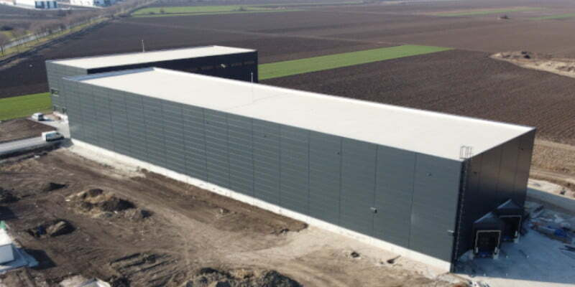



About Me
Counter-Terrorist Battalion
Serbian Special Forces
Retail Manager
Viking Cruise Line
Retail Network Manager
Alumil Yu Industry
Data Engineer
Microsoft Certified
Expert Group
Logistics and Production Manager
Mega Plast Jovanovic doo

Slide 6


About Me
Programming languages
SQL (2019)
Java (2019)
Python (2020)
Scala/Spark (2020)
C/C++ (2021)
Rust (2021)
ELUSION (19 Dec 2024)

Slide 7
Why Elusion?
WHY WOULD YOU USE ELUSION?
Elusion wants you to be you! With Elusion you can use your own logic and function ordering, as you will always get the same results regardless of DataFrame function order.
Simple DataFrame API constructs, that can be easily understood and used by SQL and DataFrame users, from the first day on.
Power of Rust 🦀 , without the need-to-know Rust.
Native Pipeline Scheduler for workflow automation.
Native Reporting/Dashboard capabilities.
Native Backend capabilities: Data Extraction from REST API endpoints.

Slide 8
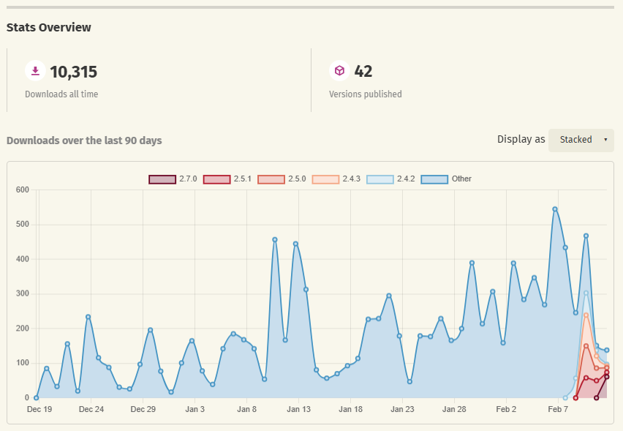
Why Elusion?
WHY WOULD YOU USE ELUSION?

Slide 9
Motivation

Slide 10
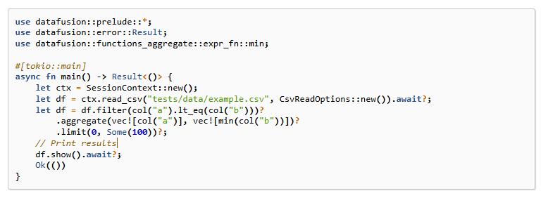
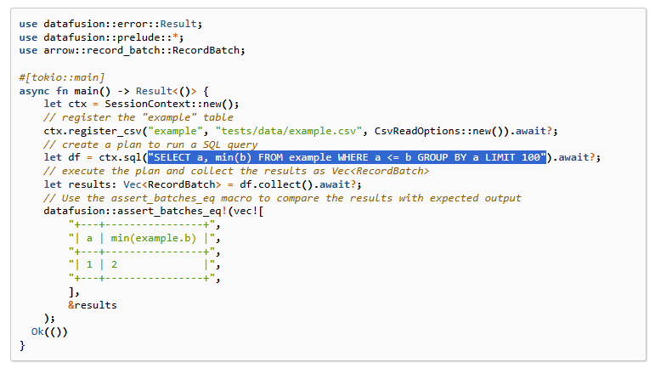
Why Elusion?
DataFusion DataFrame API
DataFusion SQL API

Slide 11
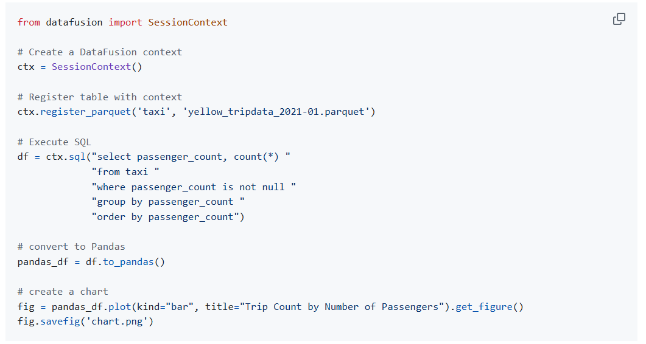
Why Elusion?
DataFusion Python 🐍 Bindings

Slide 12
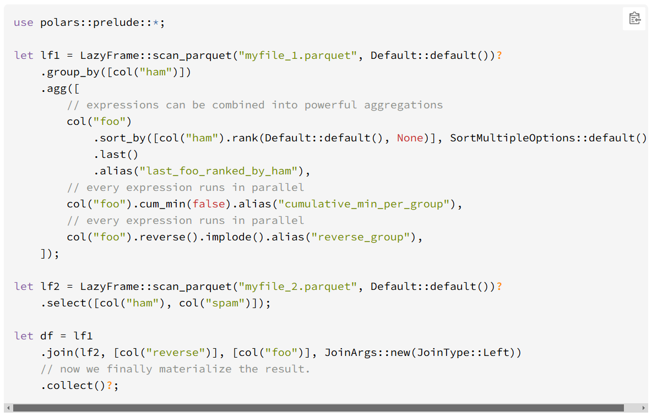
Why Elusion?
Polars RUST 🦀 DataFrame API

Slide 13
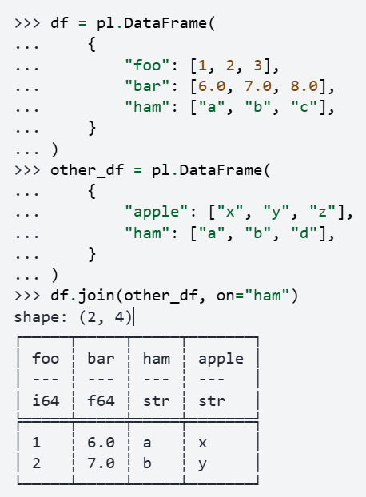
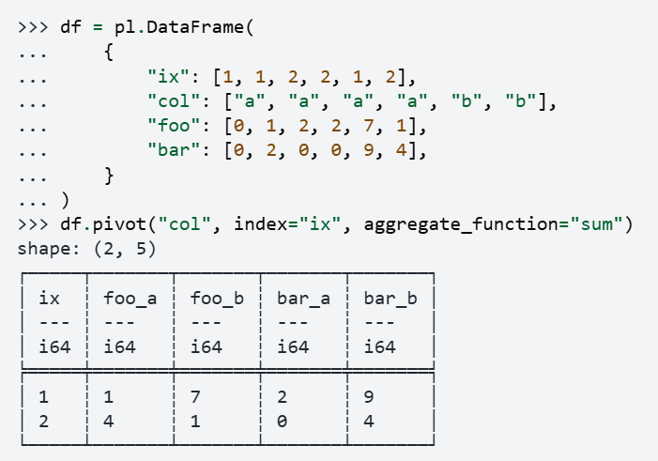
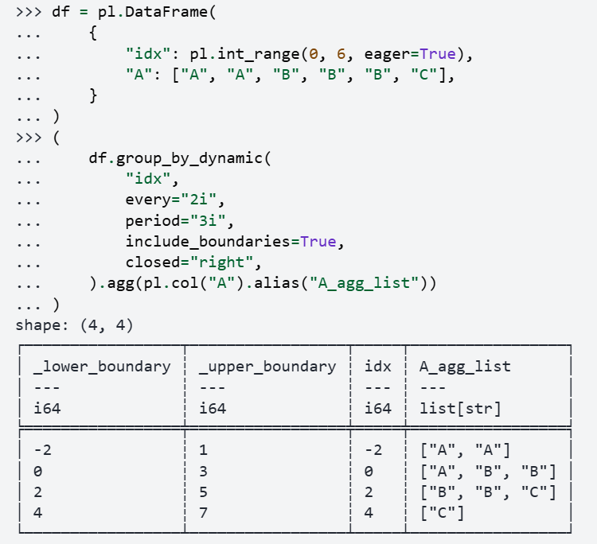
Why Elusion?
Polars PYTHON 🐍 DataFrame API

Slide 14


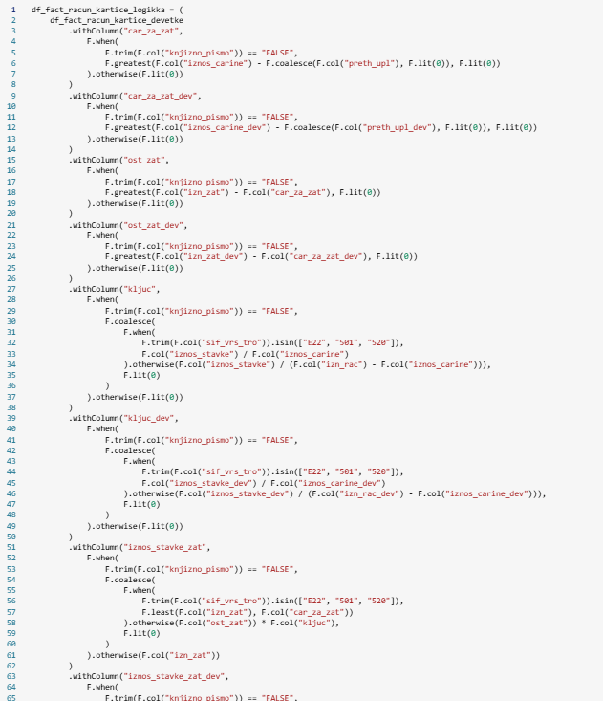
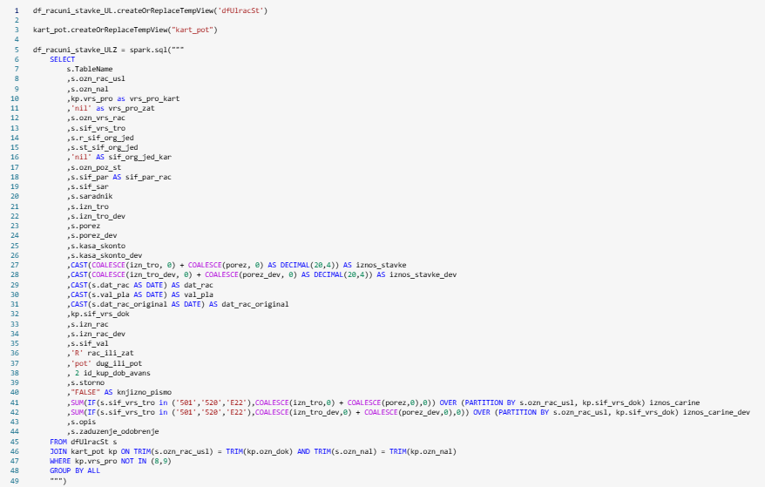
Why Elusion?
Data Engineer
PySpark
SQL

Slide 15
Why Elusion?
GOALS
1. Create simple DataFrame API constructs, that can be easily understood and used by SQL and DataFrame users, from the first day on.
2. Make RUST 🦀 feels approachable for the newcomers, and current DataFrame users of the popular Python 🐍 Libraries: Pandas, Polars and PySpark.
3. Allow users to apply their own logic for Query construction, without the need to strictly enforce function orders.
4. Create Backend capabilities for Data Engineers.
5. Create Reporting Capabilities.

Slide 16
DataFusion

Slide 17

Data Fusion
Operators
Numerical Operators
Comparison Operators
Logical Operators
Bitwise Operators
Other Operators
SQL Reference
Window Functions
Syntax
Aggregate functions
Ranking Functions
Analytical Functions
Aggregate Functions
General Functions
Statistical Functions
Approximate Functions
https://datafusion.apache.org/user-guide/sql/index.html
Data Types
Character Types
Numeric Types
Date/Time Types
Boolean Types
Binary Types
Unsupported SQL Types
Supported Arrow Types
SELECT syntax
WITH clause
SELECT clause
FROM clause
WHERE clause
JOIN clause
GROUP BY clause
HAVING clause
UNION clause
ORDER BY clause
LIMIT clause
EXCLUDE and EXCEPT clause
Subqueries
Subquery operators
SELECT clause subqueries
FROM clause subqueries
WHERE clause subqueries
HAVING clause subqueries
Subquery categories
Scalar Functions
Math Functions
Conditional Functions
String Functions
Binary String Functions
Regular Expression Functions
Time and Date Functions
Array Functions
Struct Functions
Map Functions
Hashing Functions
Other Functions

Slide 18
Meet Elusion

Slide 19
Elusion
How Elusion got it’s name?
Name Elusion comes from the mix of words Excel and DataFusion. I took ‘E’ and ‘l’ from Excel, and ‘usion’ from DataFusion.
Why Excel? 🤔
Year ago, I started a new project in Rust, with idea to create something like Excel, that would run SQL queries on some sort of worksheet/tabular sheet/matrix table...
As that project required substantial knowledge and time to build an UI, I realized that I don’t have that much time to invest in it.
When I got the idea for creating DataFrame API on top of DataFusion, I immediately came up with the name Elusion, before I even started the project.

Slide 20

Elusion
Why Chameleon Avatar?
As other DataFrame libraries has animal for Avatar (Pandas 🐼, Polars 🐻) I decided that Elusion’s avatar will be an animal.
But…I didn’t want some big and powerful animal, as that felt like I am copying them.
Because the word "Elusion" is reminiscent of "Illusion," I was inspired by the Chameleon - an animal that changes its skin color to blend seamlessly into its surroundings, creating the impression of being part of its environment.

Slide 21
Prerequisites

Slide 22
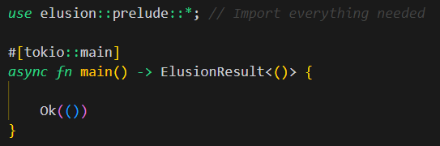
Elusion
Prerequisites:
To be able to use all 🦎 Elusion features you need to install RUST version >= 1.81
Cargo.toml:
In Cargo.toml file you need to add 2 dependencies:
[dependencies]
elusion = “2.7.0”
tokio = { version = “1.42.0” , features = [ “rt-multi-thread” ] }
MAIN Function:
To have all 🦎 Elusion features at your disposal, simply add: use elusion::prelude::*
On top of Main function add: #[tokio::main] , asynchronous Runtime that is necessary for 🦎 Elusion
Add return type -> ElusionResult<()> , which will return Result if everything is fine, or it will return an Error

Slide 23
READERS and WRITERS

Slide 24
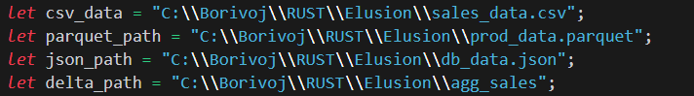

Elusion
Readers (In-memory Files):
All Files types are transferred to DataFrame through CustomDataFrame::new() by supplying file path and alias
For Delta Tables we specify Path to the Folder, without file extension
Path
***Schema is Inferred Dynamically***
Alias

Slide 25
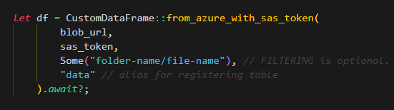
Elusion
Readers (Database):
For DB queries we use CustomDataFrame::from_db() by supplying connection string and sql query
Connection String
SQL Query
Readers (Azure BLOB storage):
For DB queries we use CustomDataFrame::from_db() by supplying connection string and sql query
URL
SAS Token

Slide 26
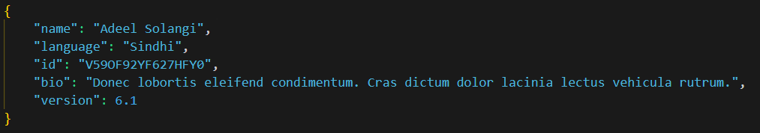
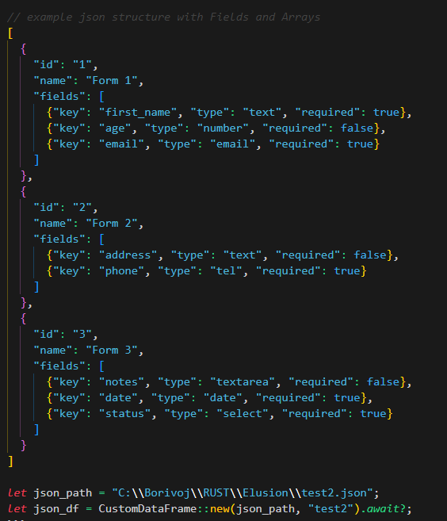
Elusion
JSON reader:
JSON reader currently can read 2 document forms:
{ Key: Value }
{ Field: [{ Array }, { Array }, { Array }] }

Slide 27
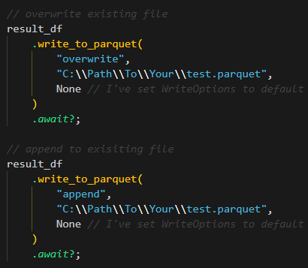
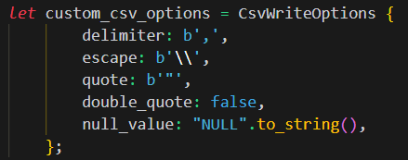
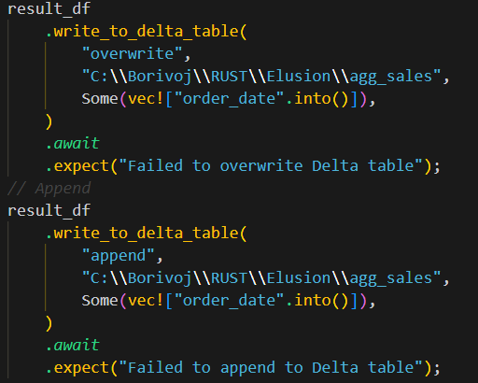
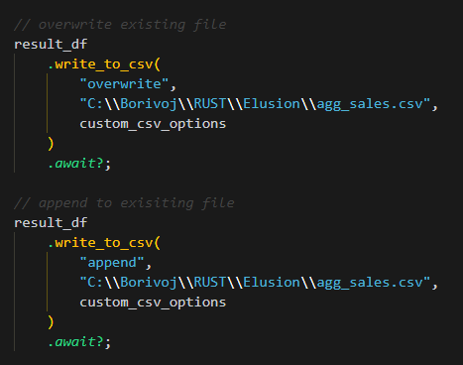
Elusion
Writers:
PARQUET
WriteOptions set to default for writing Parquet files, so keep it None
CSV
has_headers: TRUE is dynamically set for Overwrite mode, and FALSE for Append mode
DELTA
Partitioning column is optiona (Some or None) Partittioned column can’t be read after partitioning

Slide 28
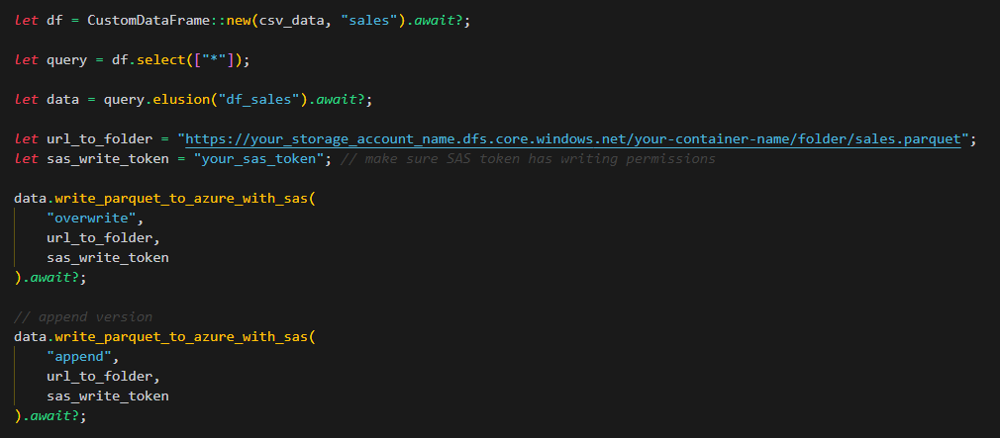
Elusion
Writers:
PARQUET to AZURE BLOB Storage
Writing is set to Default, Compression SNAPPY and Parquet 2.0, Buffer Size 1GB

Slide 29
Data Wrangling

Slide 30
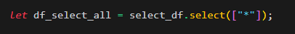
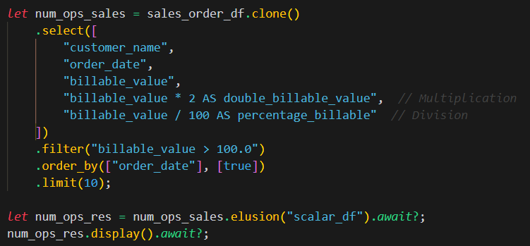
Elusion
SELECT:
NUMERICAL OPERATORS:
Numerical Operators supported: + - * / %

Slide 31
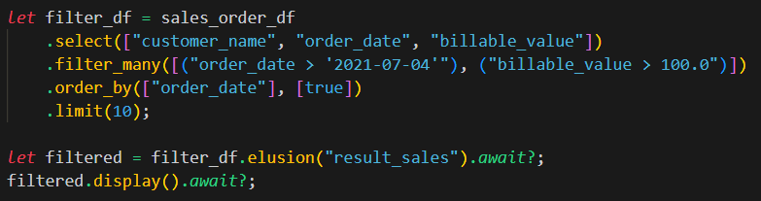
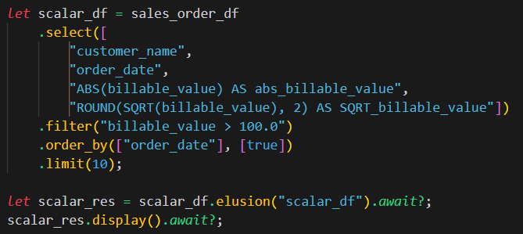
Elusion
FILTER:
Filter has 2 variants: filter() and filter_many()
SCALAR Functions:
Scalar Functions are used within select() function

Slide 32
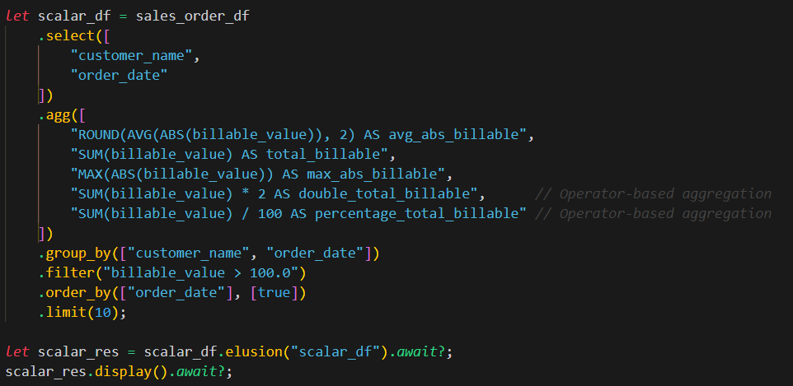
Elusion
AGGREGATE functions:
Aggregate Functions are used under agg() function

Slide 33
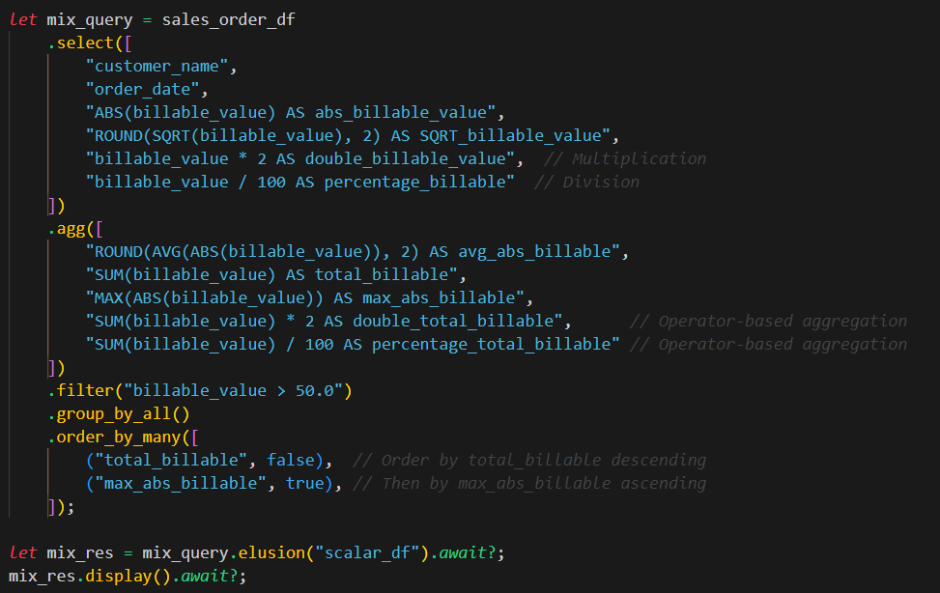
Elusion
Aggregations, Scalar Functions, Numeric Operators:
group_by_all() Takes all non-aggregated columns from select() and string_functions() (which we will se soon)
ORDERING has 2 variants: order_by() and order_by_many()

Slide 34
Elusion
Currently supported Aggregate functions:
SUM, AVG, MEAN, MEDIAN, MIN, COUNT,MAX,
LAST_VALUE, FIRST_VALUE,
GROUPING, STRING_AGG, ARRAY_AGG, VAR,VAR_POP,VAR_POPULATION,VAR_SAMP,VAR_SAMPLE,
BIT_AND, BIT_OR, BIT_XOR, BOOL_AND, BOOL_OR
Currently supported Scalar functions:
ABS, FLOOR, CEIL, SQRT, ISNAN, ISZERO,
PI, POW, POWER, RADIANS, RANDOM, ROUND,
FACTORIAL, ACOS, ACOSH, ASIN, ASINH,
COS, COSH, COT, DEGREES, EXP,
SIN, SINH, TAN, TANH, TRUNC, CBRT,
ATAN, ATAN2, ATANH, GCD, LCM, LN,
LOG, LOG10, LOG2, NANVL, SIGNUM

Slide 35
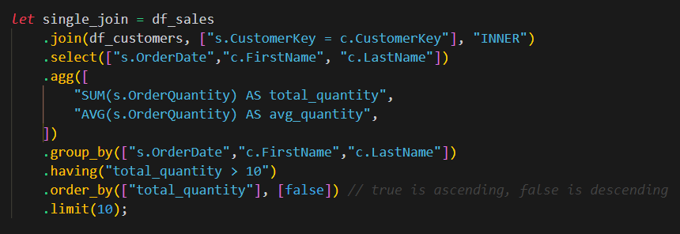
Elusion
JOIN:
For joining 2 dataframes we should use join() function:

Slide 36
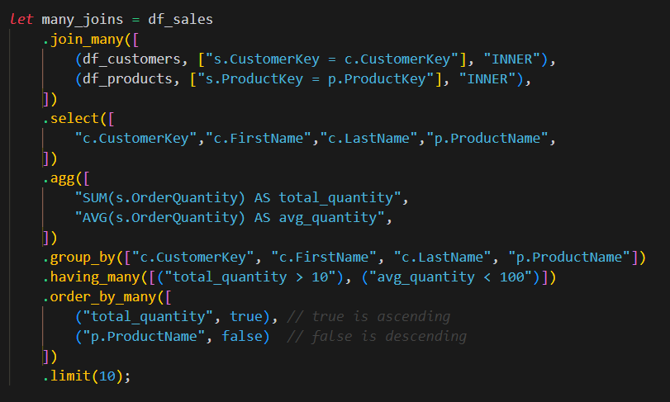
Elusion
JOIN:
For joining more than 2 data frames, we should use join_many() function:

Slide 37
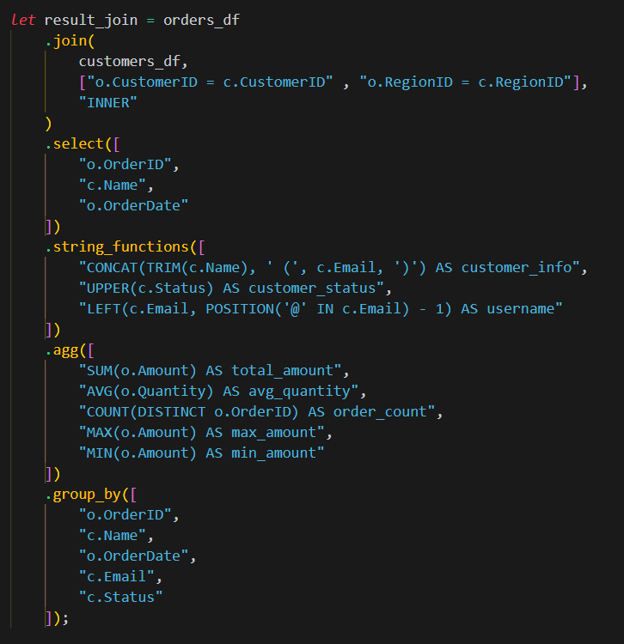
Elusion
JOIN:
Support for multiple joining conditions in join():

Slide 38
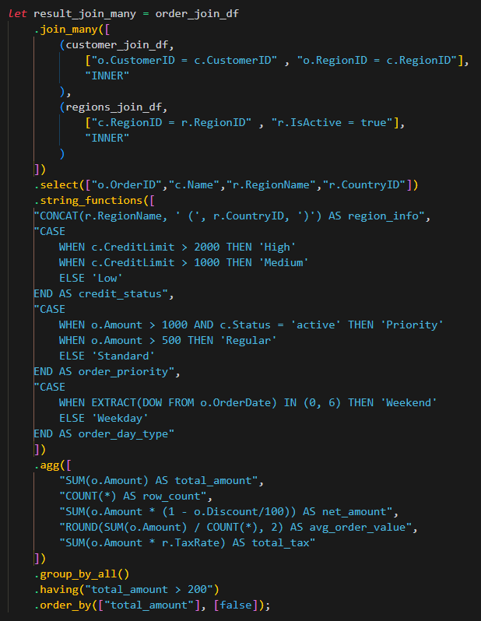
Elusion
JOIN:
Support for multiple joining conditions in join_many():

Slide 39
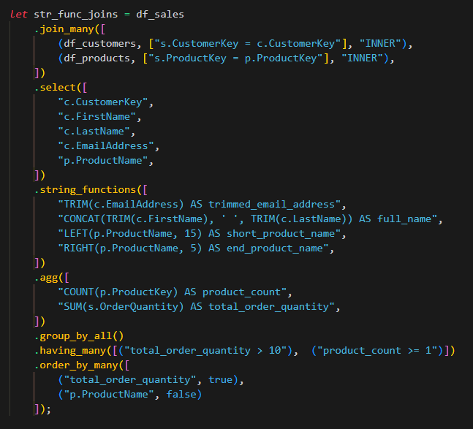
Elusion
JOIN:
Joining more than 2 data frames PLUS: STRING FUNCTIONS, AGGREGATION, GROUP BY, HAVING_MANY, ORDER BY:

Slide 40
Elusion
Currently implemented JOINs:
"INNER"
"LEFT"
"RIGHT"
"FULL"
"LEFT SEMI"
"RIGHT SEMI"
"LEFT ANTI"
"RIGHT ANTI“
"LEFT MARK"

Slide 41
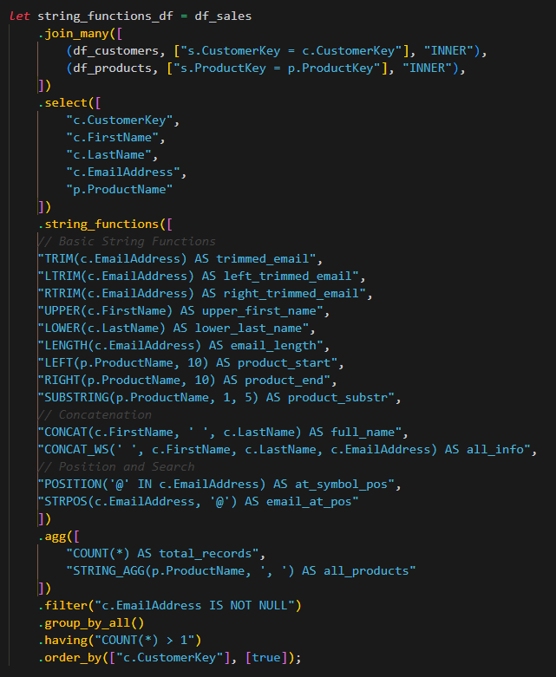
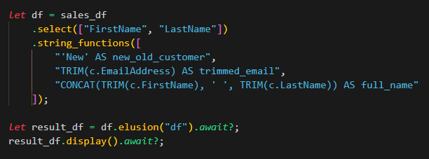
Elusion
String Functions:
All functions that are used on STRING/TEXT/VARCHAR Columns are String Functions and can be used within string_functions()

Slide 42
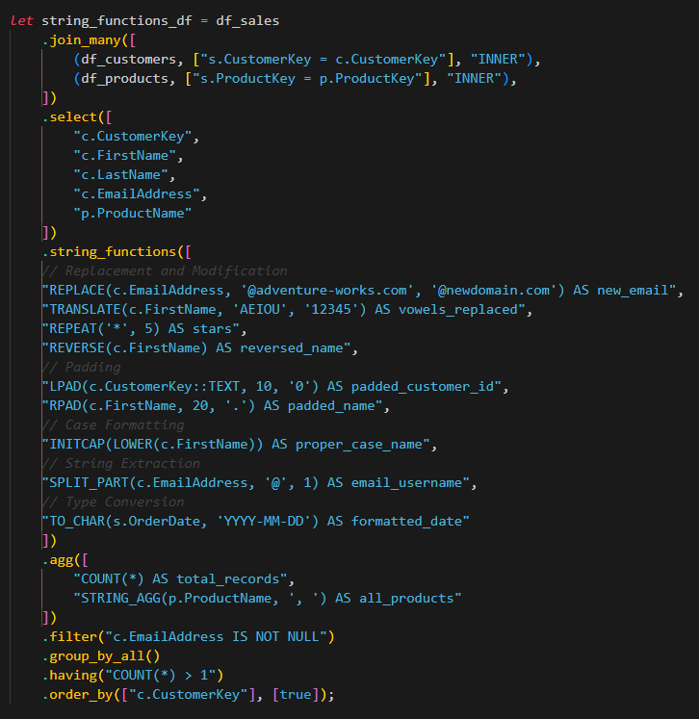
Elusion
String Functions (more examples):

Slide 43
Elusion
Currently available String Functions:
1.Basic String Functions:
TRIM() - Remove leading/trailing spaces
LTRIM() - Remove leading spaces
RTRIM() - Remove trailing spaces
UPPER() - Convert to uppercase
LOWER() - Convert to lowercase
LENGTH() or LEN() - Get string length
LEFT() - Extract leftmost characters
RIGHT() - Extract rightmost characters
SUBSTRING() - Extract part of string
2. String concatenation:
CONCAT() - Concatenate strings
CONCAT_WS() - Concatenate with separator
3. String Position and Search:
POSITION() - Find position of substring
STRPOS() - Find position of substring
INSTR() - Find position of substring
LOCATE() - Find position of substring
6. String Padding:
LPAD() - Pad string on left
RPAD() - Pad string on right
SPACE() - Generate spaces
4. String Replacement and Modification:
REPLACE() - Replace all occurrences of substring
TRANSLATE() - Replace characters
OVERLAY() - Replace portion of string
REPEAT() - Repeat string
REVERSE() - Reverse string characters
7. String Case Formatting:
INITCAP() - Capitalize first letter of each word
8. String Extraction:
SPLIT_PART() - Split string and get nth part
SUBSTR() - Get substring
5. String Pattern Matching:
LIKE() - Pattern matching with wildcards
REGEXP() or RLIKE() - Pattern matching with regular expressions
9. String Type Conversion:
TO_CHAR() - Convert to string
CAST() - Type conversion
CONVERT() - Type conversion
10. Control Flow:
CASE

Slide 44
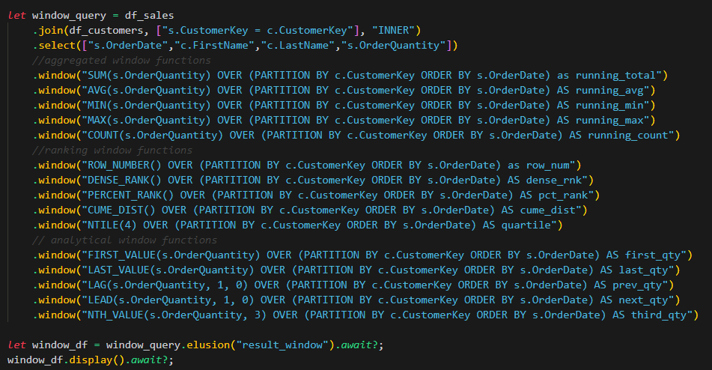
Elusion
WINDOW:
Aggregated, Ranking and Analytical Window functions:

Slide 45
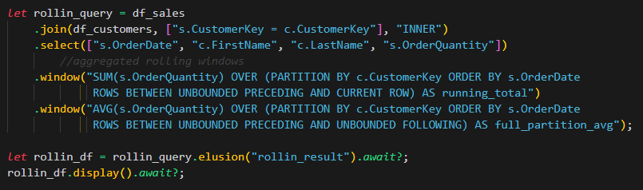
Elusion
WINDOW:
Rolling Window functions:

Slide 46
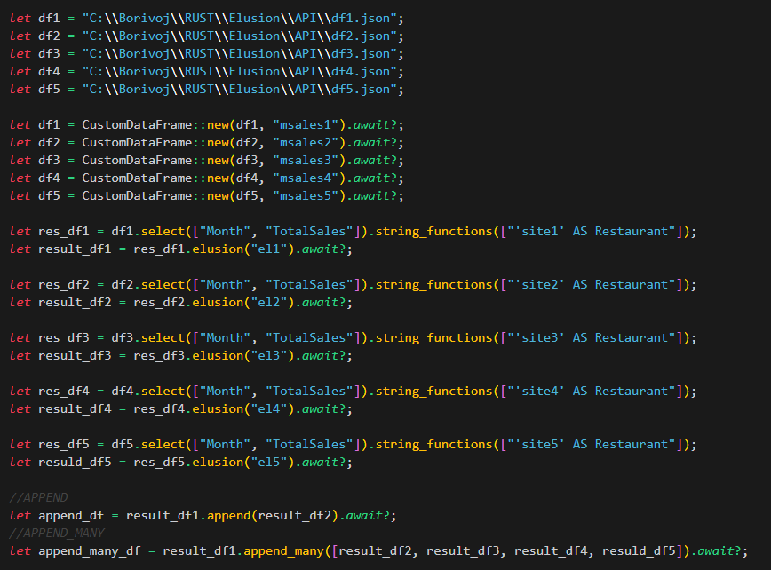
Elusion
APPEND, APPEND MANY:
APPEND: Combines rows from both
APPEND MANY: Combines rows from many dataframes

Slide 47
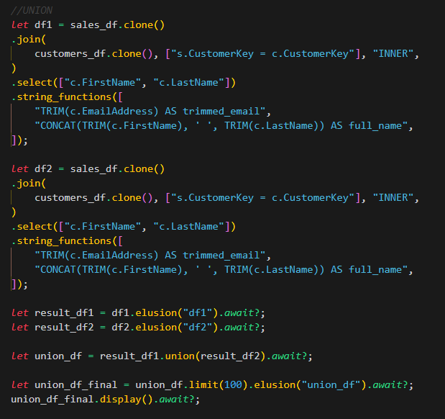
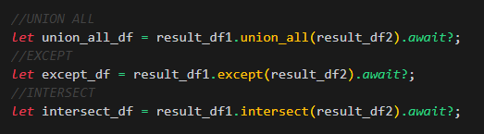
Elusion
UNION, UNION ALL, EXCEPT and INTERSECT:
UNION: Combines rows from both, removing duplicates
UNION ALL: Combines rows from both, keeping duplicates
EXCEPT: Difference of two sets (only rows in left minus those in right)
INTERSECT: Intersection of two sets (only rows in both)
We can use other functions in a same manner as union():

Slide 48
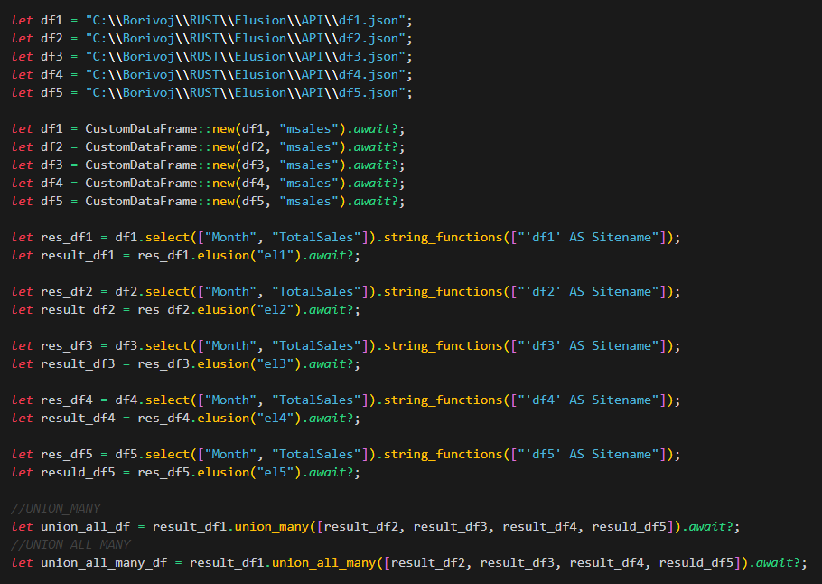
Elusion
UNION_MANY, UNION_ALL_MANY:
UNION MANY: Combines rows from many dataframes, removing duplicates
UNION ALL MANY: Combines rows from many dataframes, keeping duplicates

Slide 49
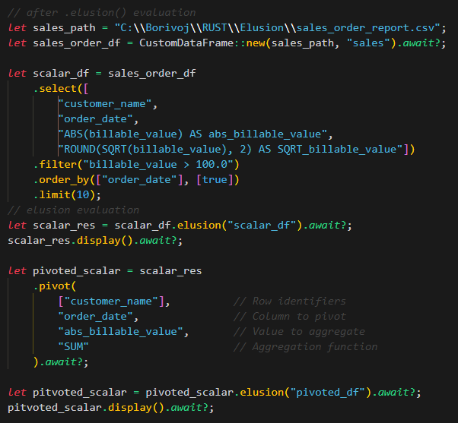
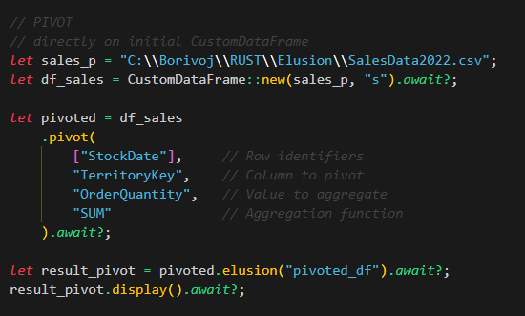
Elusion
PIVOT:
Pivot function is ASYNC function. Should be used separately from other functions:
Directly on initial CustomDataFrame,
After .elusion() evaluation:
***Future needs to be in final state so .await? must be used***

Slide 50
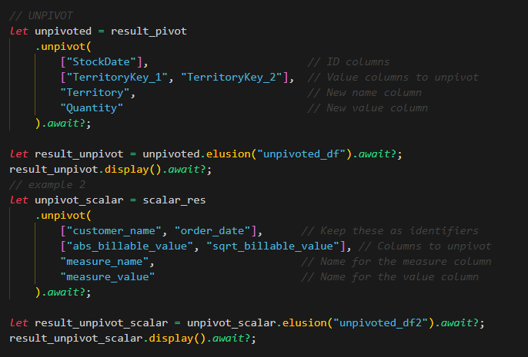
Elusion
UNPIVOT:
Unpivot function is ASYNC function. Should be used separately from other functions:
Directly on initial CustomDataFrame,
After .elusion() evaluation:
***Future needs to be in final state so .await? must be used***

Slide 51
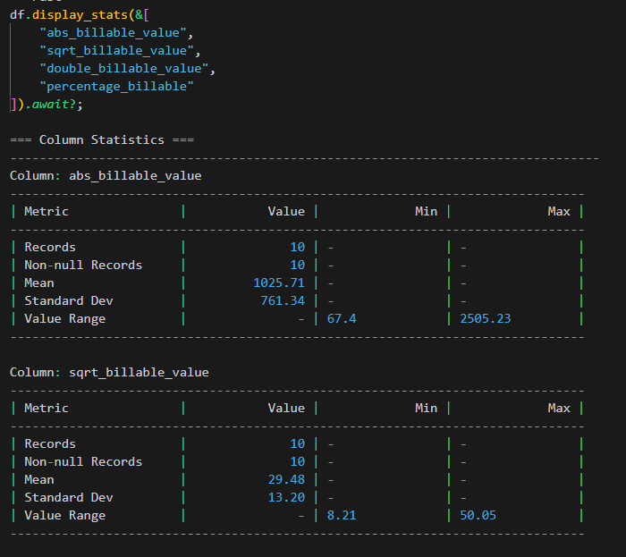
Elusion
STATISTICAL FUNCTIONS:
You can use statistical functions to quickly check your column stats, correlations and null analysis
display_stats()

Slide 52
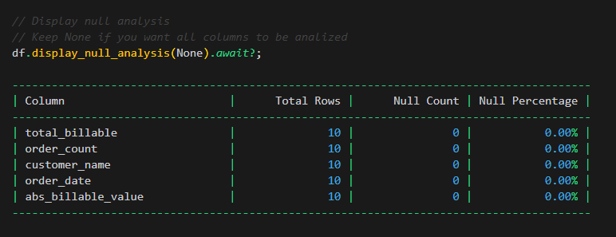
Elusion
STATISTICAL FUNCTIONS:
display_null_analysis()

Slide 53
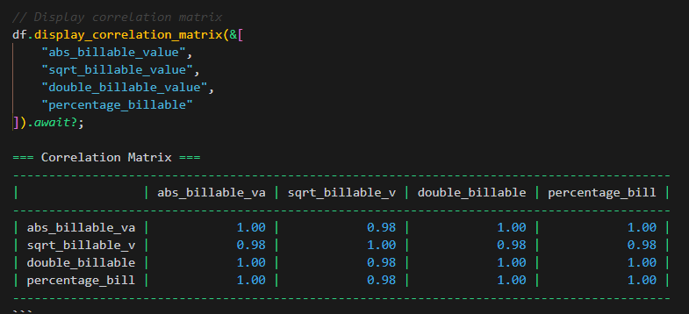
Elusion
STATISTICAL FUNCTIONS:
display_correlation_matrix()

Slide 54
ODBC – Open Database Connectivity

Slide 55
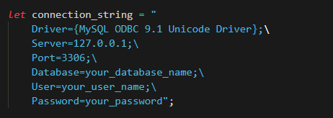
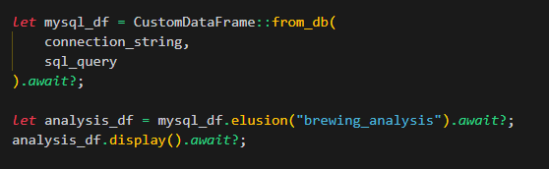
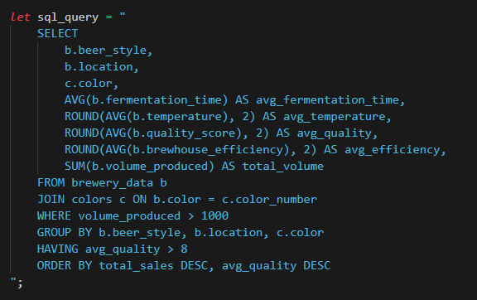
Elusion
ODBC MySQL:
ODBC Connectors currently support MySQL and PostgreSQL

Slide 56


Elusion
ODBC PostgreSQL:

Slide 57
Azure BLOB Storage

Slide 58

Elusion
Azure BLOB Storage (Reading):
Storage connector available with BLOB and DFS url endpoints, along with SAS token provided.
Currently supported file types .JSON and .CSV
DFS endpoint is “Data Lake Storage Gen2” and behave more like a real file system. This makes reading operations more efficient—especially at large scale.

Slide 59
REST API

Slide 60

Elusion
REST API
REST API is made for creating JSON files from API endpoints.
Customizable: Headers, Params, Pagination, Date Ranges
FROM API

Slide 61

Elusion
REST API
FROM API WITH HEADERS

Slide 62

Elusion
REST API
FROM API WITH PARAMS

Slide 63

Elusion
REST API
FROM API WITH PARAMS AND HEADERS

Slide 64

Elusion
REST API
FROM API WITH DATES

Slide 65


Elusion
REST API
FROM API WITH PAGINATION
FROM API WITH SORT

Slide 66

Elusion
REST API
FROM API WITH HEADERS AND SORT

Slide 67
Reporting / Dashboards

Slide 68


Elusion
DASHBOARD:
PLOTS:
Each Plot requires several arguments: X and Y axes, Optional (markers, groupings…) and Title
Currently Available Plots: Bar, Line, Pie, Donut, Histogram, Time Series, Box

Slide 69


Elusion
DASHBOARD:
TABLES:
Plots and Tables gathering:

Slide 70


Elusion
DASHBOARD:
Report Creation:

Slide 71

Elusion
DASHBOARD DEMO:
Toggle, Resize, Reorder, Filter, Download Excel and CSV:

Slide 72
Pipeline Scheduling

Slide 73


Elusion
Pipeline Scheduling:
Place you ETL workflow inside of PiplineScheduler::new() set your refresh frequency time and run.
Currently Available Job Frequencies:

Slide 74
Development

Slide 75
Elusion
Pending implementations:
Inline parameters
S3 Connector
Date Functions
Reading Parquet from Azure BLOB

Slide 76
Elusion
THANK YOU FOR USING ELUSION!
Crates.io
https://crates.io/crates/elusion
🦎 Elusion Creator:
Borivoj Grujicic M.Sc.
Data Engineer
GitHub.com
https://github.com/DataBora/elusion
YouTube.com
https://www.youtube.com/@RustyBiz

